Slide 1
King County Housing Data
Presented by:
Dharun Selvan
Rosario Fabian
Ashay Kargaonkar

Slide 2
AGENDA
Introduction
Project Info
Data Preparation
Modeling
Validation
Implementation

Slide 3
INTRODUCTION
We are going to predict the price of a house depending upon the different variables/factors.
King county is in the state Washington. This dataset also covers few parts of Seattle.
Data set was created on 2017 and contains data about the houses built from 1900 to 2015
The dataset contains 21 variables and 21613 observations.
The original data set was taken from Kaggle.com

Slide 4
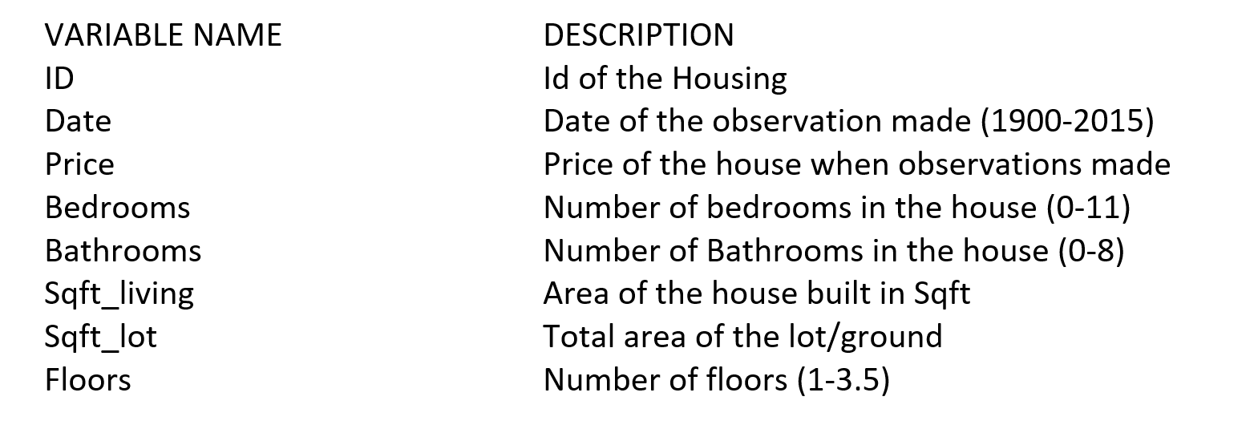
Project Info
The Model we used : Regression Model
The software we used in this project : SAS 9.4 ,IBM SPSS Statistics 26, MS EXCEL 2019 , Jupyter Notebook (Python V3.7) , Visual Studio 2019 (Visual Basic)
Data Variables in the Data Set:

Slide 5
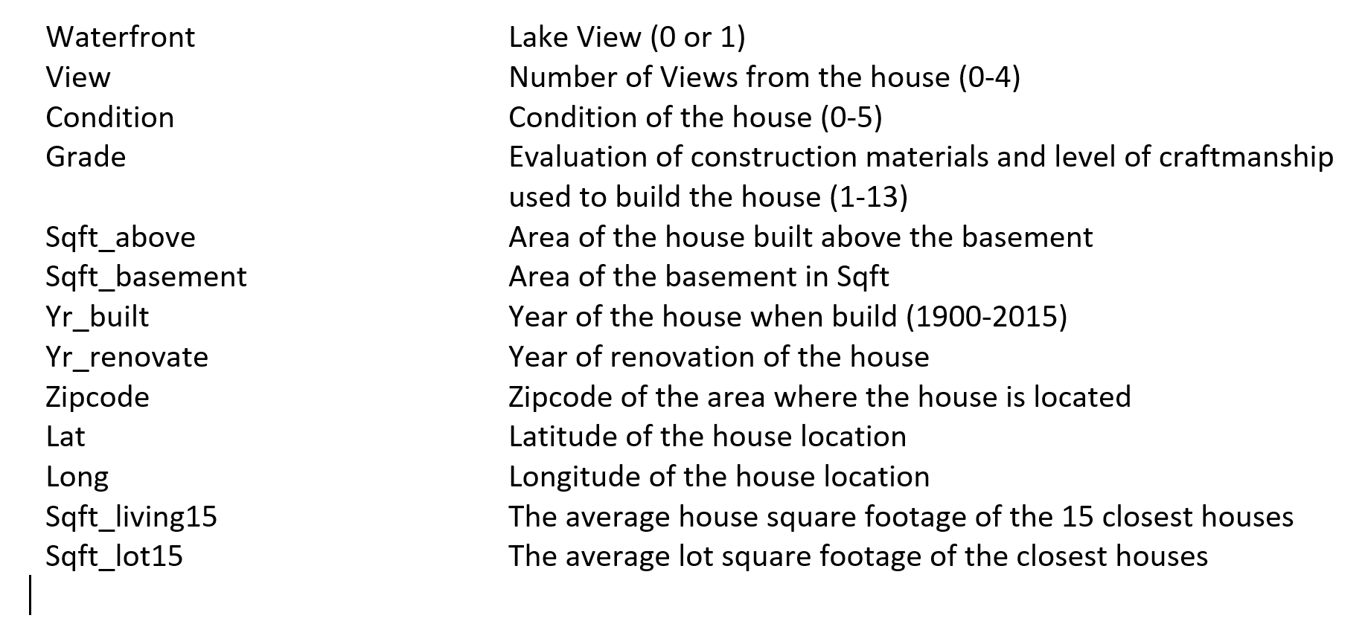
Project Info - Cont.

Slide 6
DATA PREPROCESSING
Data Preprocessing was done using Python,SPSS and Excel.
Python was used to find the missing values. Those missing values were replaced with the mean value.
Dummy Variables were created for zipcode, basements, renovations and views using SPSS.
With the help of Data Exploration, we identified the outliers and we came up with two final data set
  Data Set without any outliers
  Data Set with Transformed values of Outliers

Slide 7
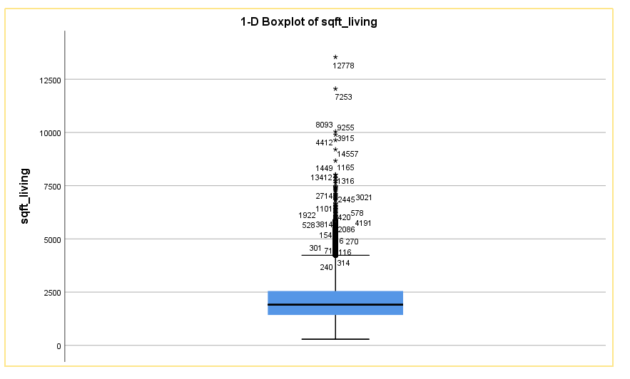
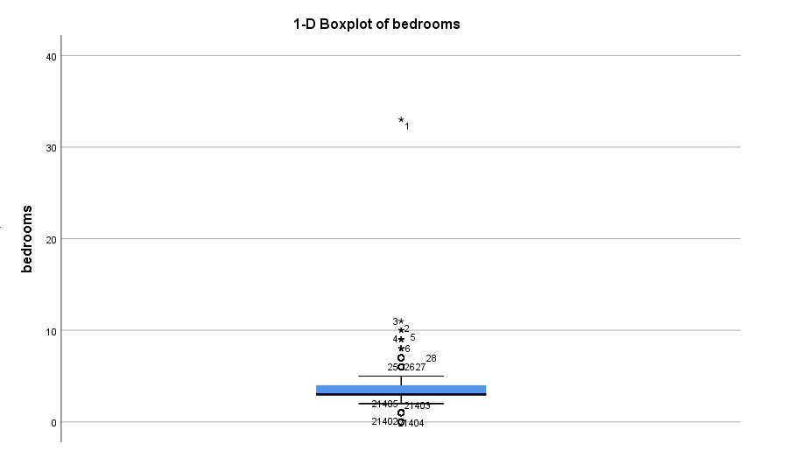
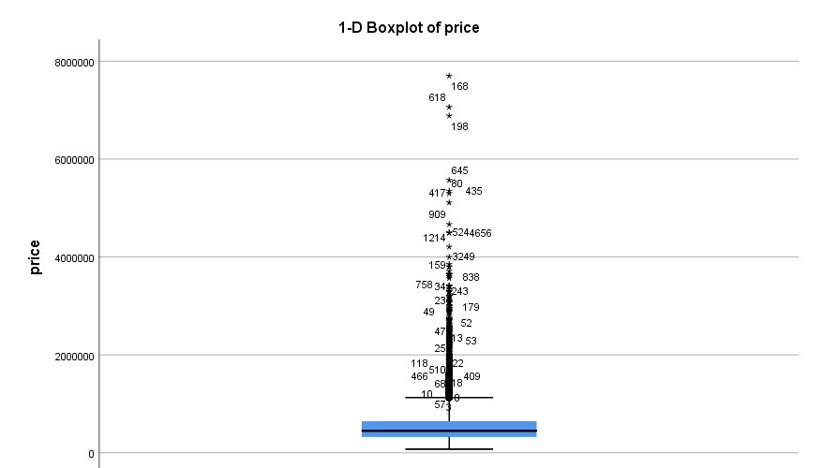
DATA PREPROCESSING-Cont.
Outliers found in sqft_living, bedrooms and price

Slide 8
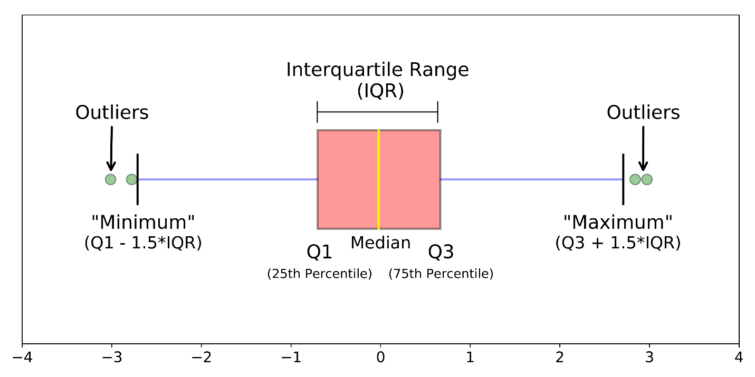
DATA PREPROCESSING-Cont.
Both data set splitted into two as train and test with 80%-20% using following python code.
The final train data set has 17289 rows and 29 columns.
Outlier were calculated using the formula shown in the right side image.

Slide 9
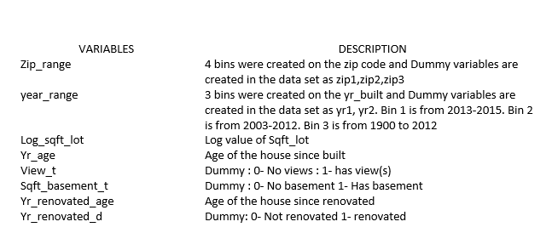
DATA PREPROCESSING-Cont.
Variables Created and Transformed:

Slide 10
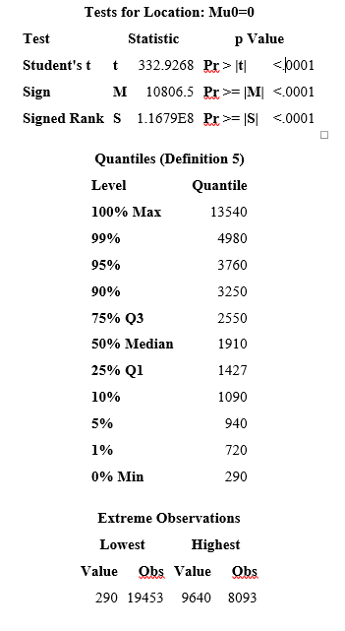
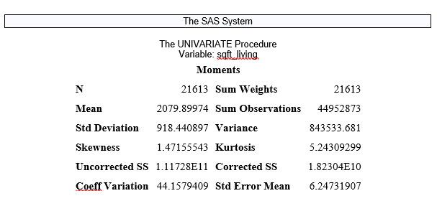
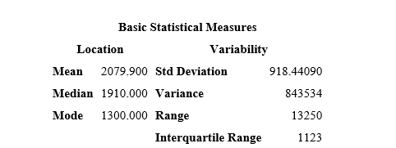
Modeling: Exploration: Univariate

Slide 11
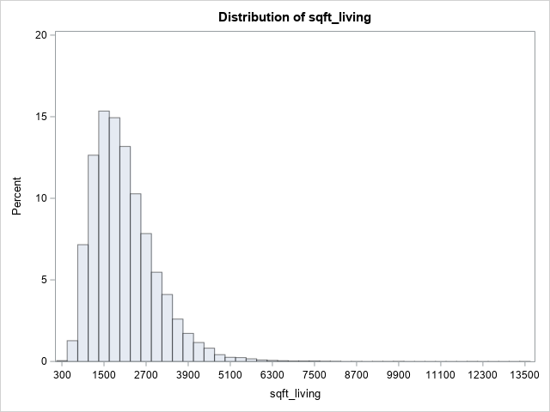
Modeling: Exploration Univariate
Size of building

Slide 12
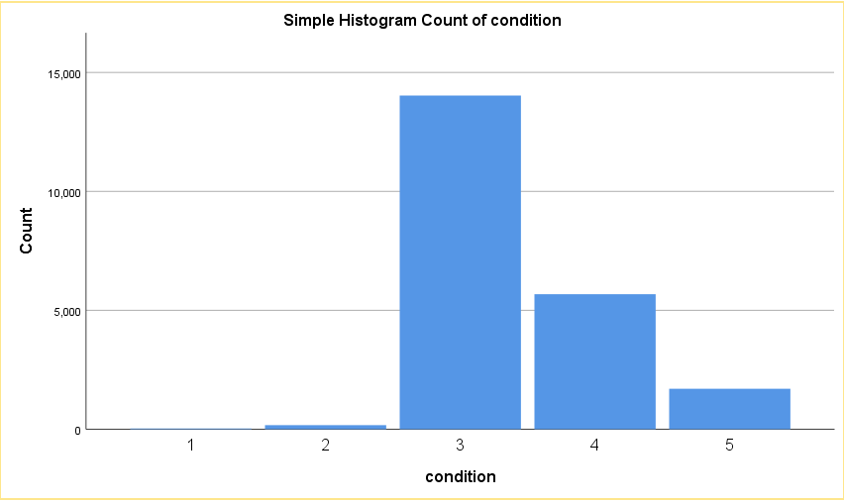
Modeling: Exploration Univariate

Slide 13
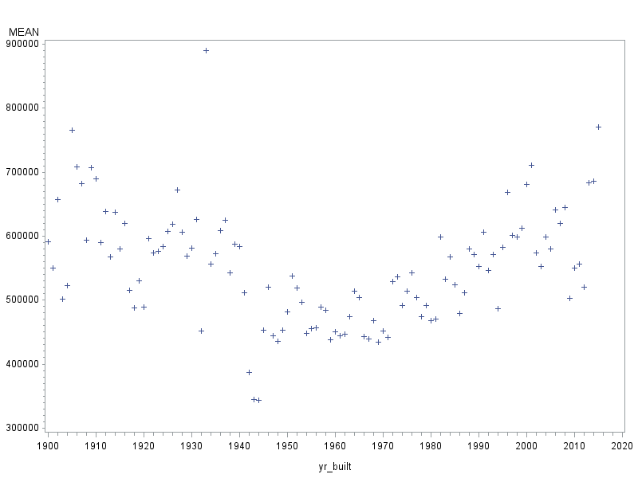
Modeling: Exploration Bivariate

Slide 14
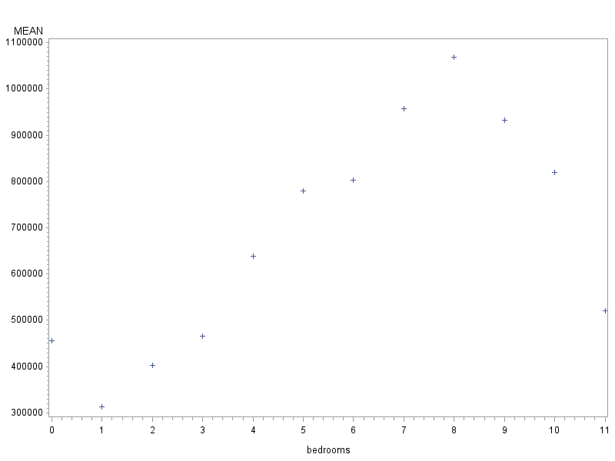
Modeling: Exploration Bivariate

Slide 15
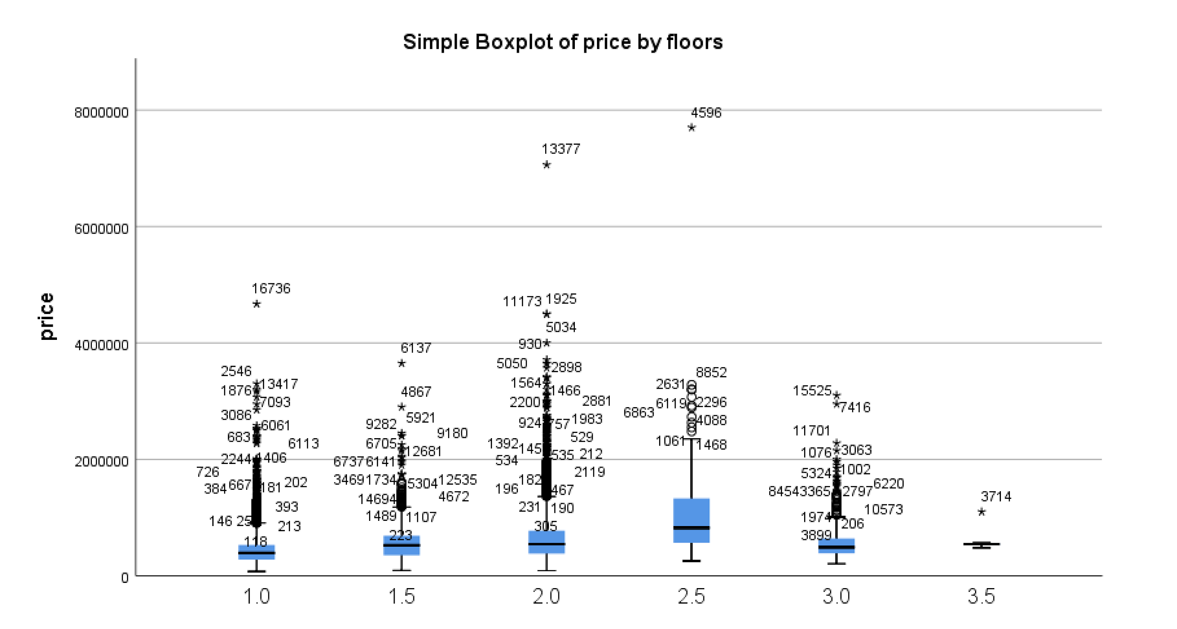
Modeling: Exploration Bivariate

Slide 16
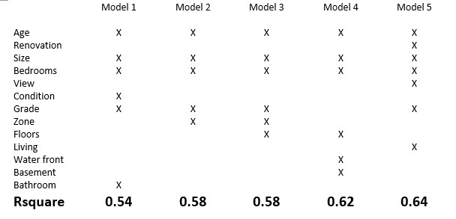
Modeling: Different Models

Slide 17
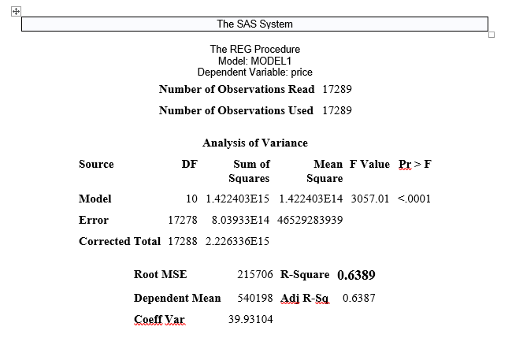
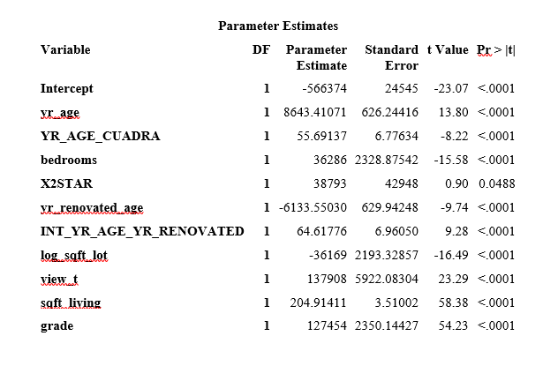
Modeling: Final Model
E(Y) = β₀+ β₁ x₁ + β₂ x₁²+ β₃ x₂+ β₄ ­(x₂ – k) + β₅ x₃ + β₆ x₁x₃ + β₇ log₂ x₄+ β₈ x₅+ β₉ x₆+ β₁₀ x₇

Slide 18
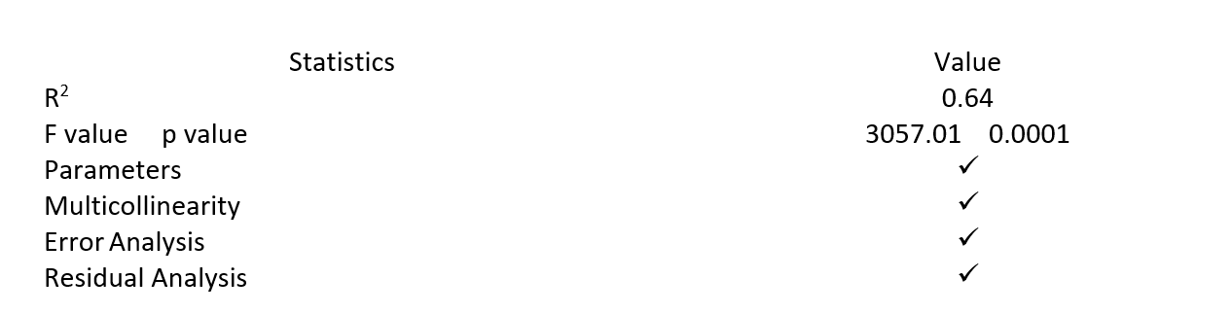
Modeling: Validation

Slide 19
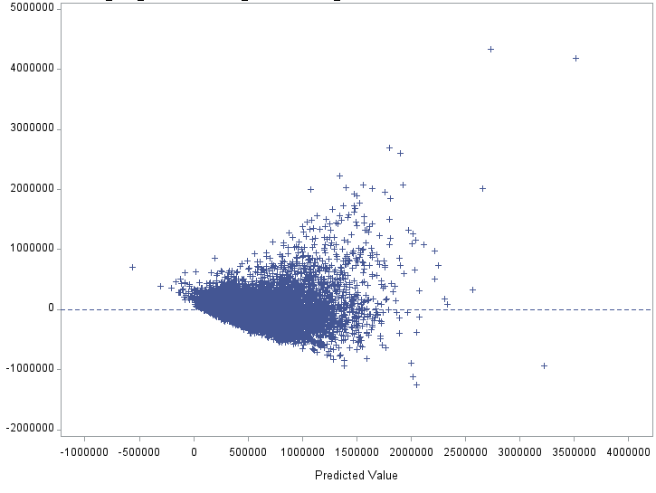
Modeling: Validation

Slide 20
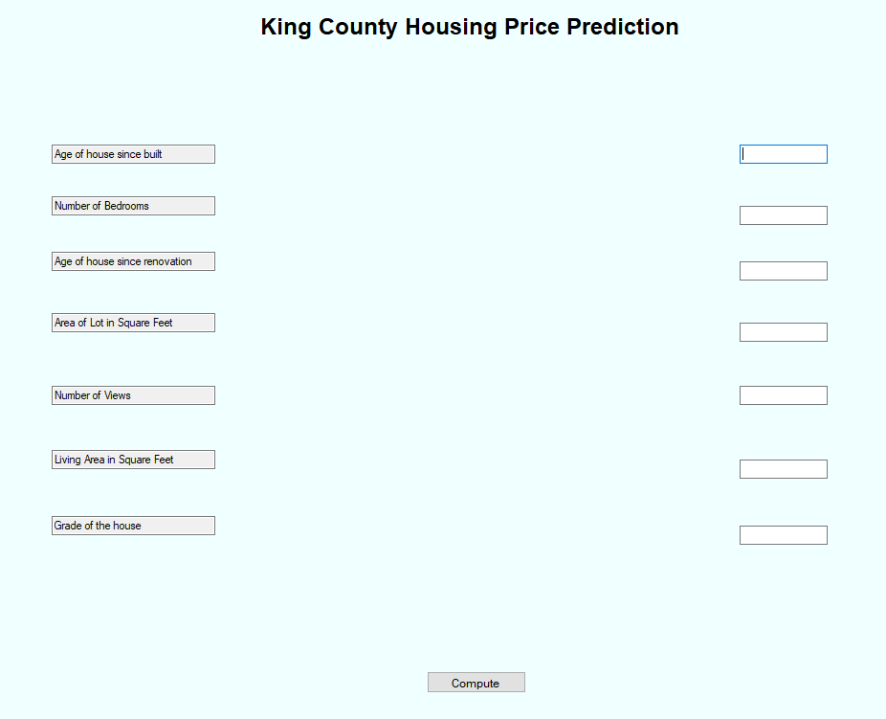
Implementation: Prediction Software
We created a prediction software using Visual Studio with the best model we created.

Slide 21
IT'S TIME FOR
DEMO
CLICK HERE

Slide 22
THANK YOU!!

